Slide 1
Period Furniture
Web Search
Using the web to search for information

Slide 2
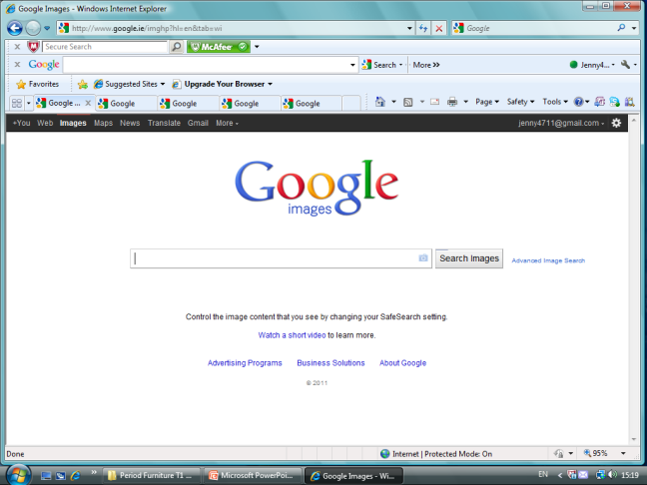
Using Google
Davenport
Click images to bring you to a different page.
Type in the word Davenport.

Slide 3
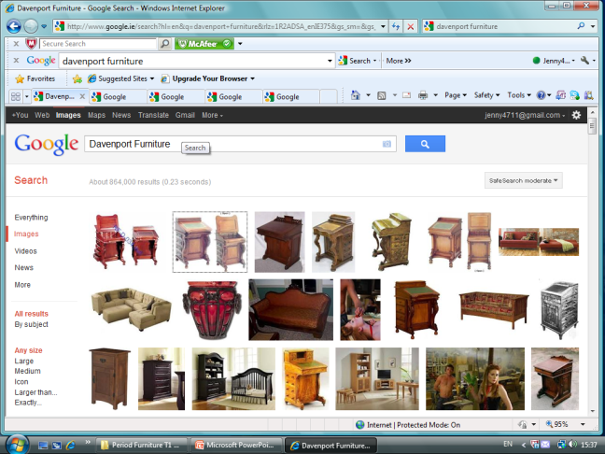
You can see we get lots of images of a Tennis Player with the surname “Davenport” so we have to narrow our search more.
Try adding Furniture.
You can click on any of these images and they will bring you to the site that they originated from.
Now we have lots of choice.

Slide 4
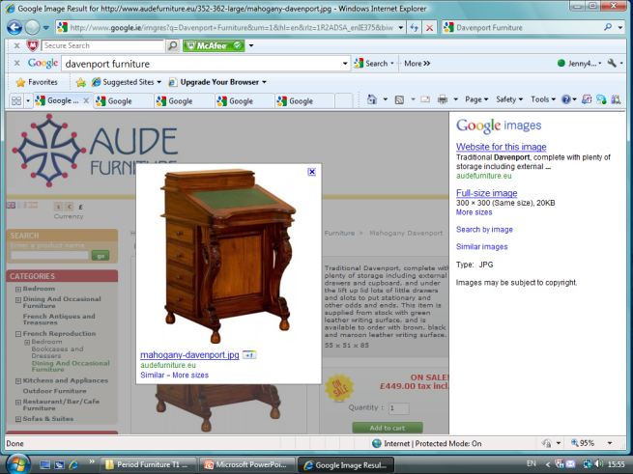
Some images will come from sites that are auctioning or selling items like these.
You will only get limited information on these sites such as material type and selling price, occasionally some information on the designer.
This image has brought us to a website selling Furniture.

Slide 5
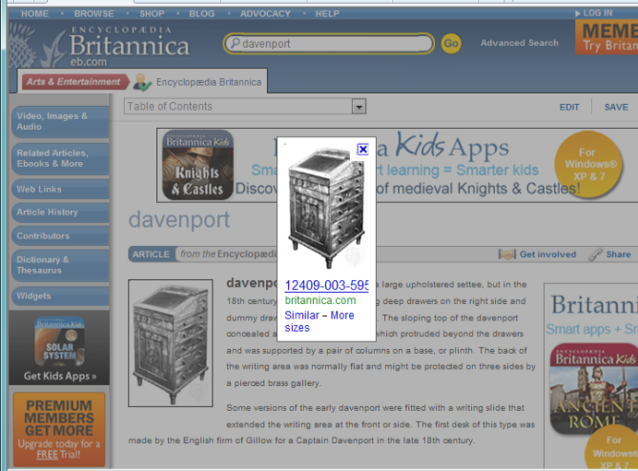
If we click on another image.
We are now on the Encyclopaedia Britannica website where we will get more useful information.

Slide 6
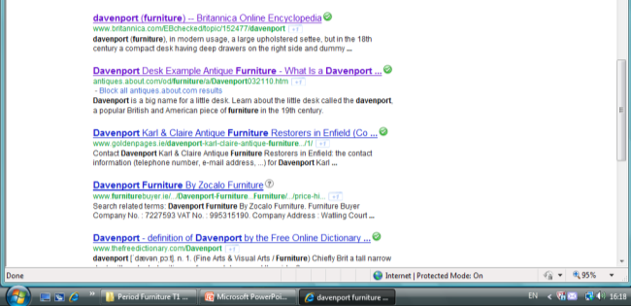
Now that you know what a Davenport is and looks like you can now click the web button to bring you to more informative sites.
Here you will be able to gather enough information to write a few lines to describe the Davenport.
Scroll down through them until you find one that gives the most accurate information.

Slide 7
Re-write in your own words the description of The Davenport.
Remember you must reference the site where you obtained the information from.

Slide 8
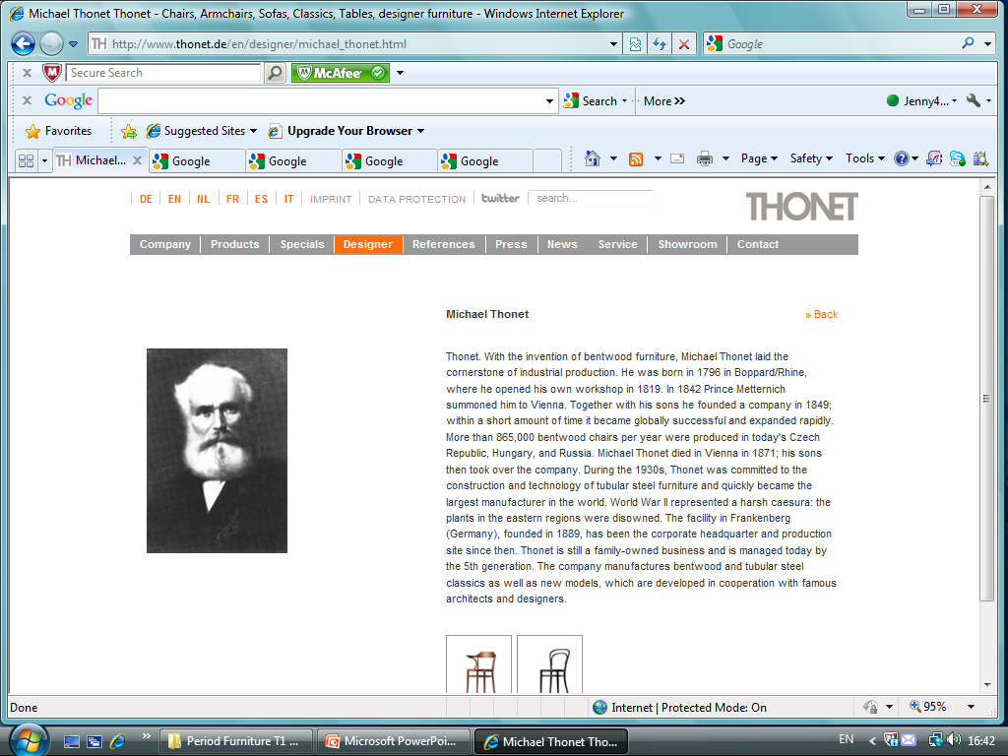
If you are researching a Name it is best to use the web first.
Be careful that you have the right person and not just some person with the same name from Face book

Slide 9
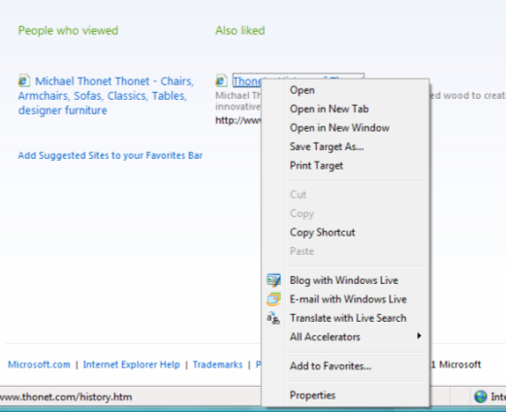
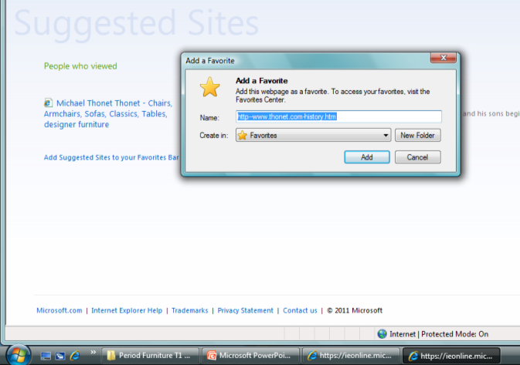
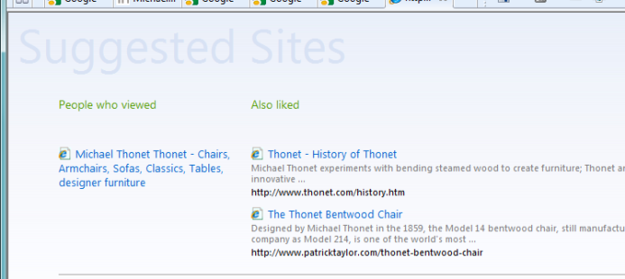
Using the Web can be very useful or very misleading. You need to look in a few places in order to check that you have the right information.
There is also a tool called suggested sites that other users have used. You may find this useful.
When you come across a good site you should save it in your favourites
Right click your mouse.

Slide 10
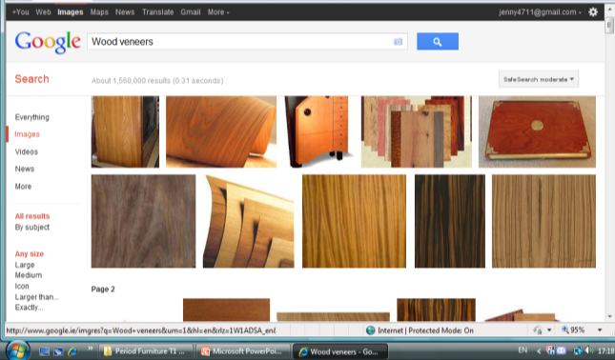
How times change. Word search : Veneers
Wood Veneers
Happy searching
If all else fails there is a really ancient but trusting tool called
A Book !

Slide 11
Independent Learning : Give a brief description of the following.
Davenport :
Sofa Table:
Carlton House Desk :
Bonheur-Du-Jour :
Card table :
Thomas Hope :
Secretaire :
Commode :
Art Nouveau :
Rent-table :
Victorian Gothic :
Roll Top Desk :
Pembroke Table :
Gilding :

Slide 12
Independent Learning : Give a brief description of the following.
Chaise Lounge :
Michael Thonet :
Arts & Crafts Furniture :
Throne Chair :
Thomas Holland :
Eileen Grey :
Regency Period Furniture :
George Smith Furniture :
Cabinet on stand :
Tall Boy :
Shaker Furniture :
Empire Chair :
Chair No. 64 :
William Morris :
Swan Neck

